Slide 1

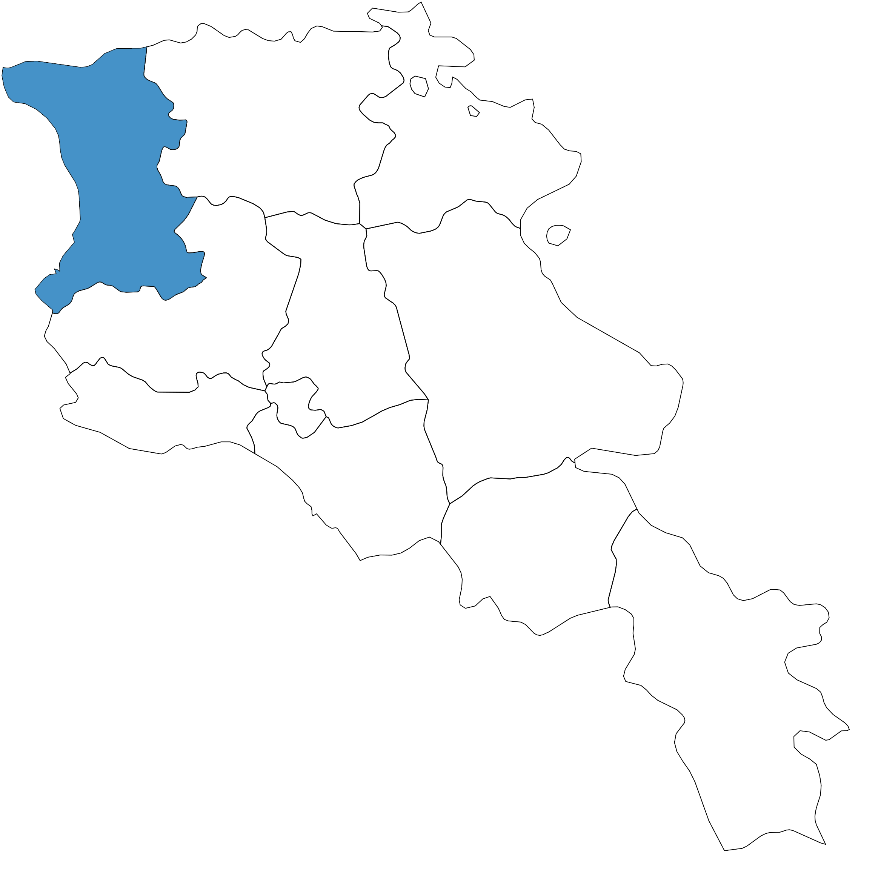
Enhancing HIV Care Accessibility in Armenia: Lessons from the Shirak Decentralization Pilot
Anna Mergelyan, Araz Chiloyan, Arusik Petrosyan, Paruyr Musheghyan
National Center of Infectious Disease Yerevan, Armenia
Introduction
Methods
Key Lessons & Next Steps
Previously, HIV care was centralized at the National Center for Infectious Diseases (NCID) in Yerevan, creating barriers for rural residents. This contributed to limited participation in antiretroviral therapy (ART) and gaps in health assessments, with 20% missing required annual viral load testing.
The program was evaluated through:
Clinical monitoring of care quality and outcomes
Statistical analysis of patient participation
Surveys and interviews with providers and beneficiaries
Case studies on patient experiences
Program implementation highlighted the importance of community involvement, regional–central collaboration, and addressing socioeconomic and informational gaps. Rural challenges underscored the need for proactive, sustainable care models.
To strengthen decentralized HIV care:
Expand services nationwide to reduce travel
Secure stable financing to avoid interruptions
Improve provider skills
Ensure service quality and reduce stigma
Establish strong coordination for site oversight
NCID is working to integrate decentralized care into the state system, with regional centers receiving state funds and NCID overseeing collaboration and quality of services.
6,300
PLHIV in Armenia
Results
4,589
aware of their status
20% (N=90) of HIV patients on ART treatment in the Shirak transitioned to the local health center. Clinical monitoring showed an increase in medical visits among these patients.
Interviews revealed key pre-decentralization barriers:
medication supply issues
high travel costs to Yerevan
feelings of insecurity when seeking distant care.
The decentralized model served an older demographic—73% of participants were over 40, compared to 63% in the national people living with HIV (PLHIV) population.
577
live in Shirak
live outside Yerevan
73%
on ART
79%
Acknowledgements
have undetectable viral load
This program is supported by The Global Fund and the National Center of Infectious Disease.
86%

